Slide 1

VibeAIthon 2025
GuardXLens: AI-Powered Watermark-Based Camera Blocking System for Secure Online Exams
A proactive AI-first solution that prevents exam leaks by detecting invisible watermarks and disabling unauthorized captures in real time.
Team Name : RIZZLERS

Slide 2

Problem — Why Current Remote Proctoring Fails
- Rapid rise in exam malpractice using secondary devices to photograph questions.
- Existing systems act after cheating happens — they rely on people watching, screen recordings, or checking later instead of stopping it in real time.
- Result: leaked question banks, eroded trust, and increased administrative cost.
- Need: a preventive, automated control that interrupts cheating the moment it happens.
Limited scalability: Human-based monitoring and manual review can't handle large-scale exams efficiently.

Slide 3

Our Solution — Preventive, Not Reactive
Two-part platform (Initially):
Exam Platform that embeds a universal invisible watermark behind every question.
AI camera that recognizes the watermark and instantly disables capture functionality on the secondary device.
Future Vision:
Integrate the GuardXLens feature at the Android system level within the Camera API and HAL layers, enabling the native camera framework to detect protected digital watermarks and automatically restrict image capture — providing OS-level prevention of online exam malpractice.
Outcome: immediate prevention of content capture, minimized human oversight, and protected question integrity.

Slide 4
Desirability — Who Benefits
Target Users:
Pain Points Solved:
User Validation:
Educational institutions, corporate organizations, government exam bodies, and EdTech platforms conducting online assessments.
Prevents cheating using secondary devices and AI tools, stops question paper leakage, ensures exam integrity, and offers a privacy-friendly alternative to invasive webcam monitoring.
Strong interest from educators and institutions for a real-time, system-level preventive solution integrated into Android — ensuring fairness, security, and scalability in online examinations.
Also beneficial for smartphone manufacturers and OS developers aiming to enhance built-in digital security features.
Reduces administrative workload and monitoring costs for large-scale online examinations.
Early conceptual feedback highlights high acceptance due to its seamless, non-intrusive integration with existing exam systems.

Slide 5
Feasibility — Technology & Architecture
Tech Stack
Android Studio, Java/Kotlin for framework integration.
TensorFlow Lite / ML Kit for AI-based watermark detection.
OpenCV for image preprocessing and pattern recognition.
Cloud server for model training and watermark dataset storage.
Development Architecture (Long-Term Vision)
Phase 1: Train AI model to detect embedded watermarks in real-time camera frames.
Phase 2: Integrate watermark detection into Android Camera API and HAL layers.
Phase 3: Implement capture-blocking logic similar to FLAG_SECURE at system level.
Phase 4: Testing across multiple Android versions and camera modules.
Resource Availability / Limitations:
Available: Open-source Android framework, ML libraries, and test devices.
Limitations: Requires system-level permissions and collaboration with Google/OEMs for OS integration.

Slide 6
Viability — Business Model & Market
Viability:
The proposed AI-based watermark detection system is designed for long-term sustainability and scalability. The system integrates a universal, visible watermark directly into the exam interface, which is detected by the default system camera via OS-level integration in real time, eliminating the need for additional apps or specialized hardware. This makes deployment cost-effective and compatible with standard devices.
Revenue / Impact Model:
Market:
Revenue can be generated by licensing the system to online exam platforms and institutions via subscription or per-exam fees. It ensures exam integrity, reduces malpractice, and protects intellectual property.
Global e-learning market > $200B. Secure assessment demand is growing post-COVID; ample expansion to corporate learning and secure document protection.
Target Market & Demand:
The global online education and assessment market is rapidly expanding, with millions of exams conducted daily in schools, universities, and corporate settings. The solution addresses a critical need for secure, scalable anti-cheating mechanisms.

Slide 7
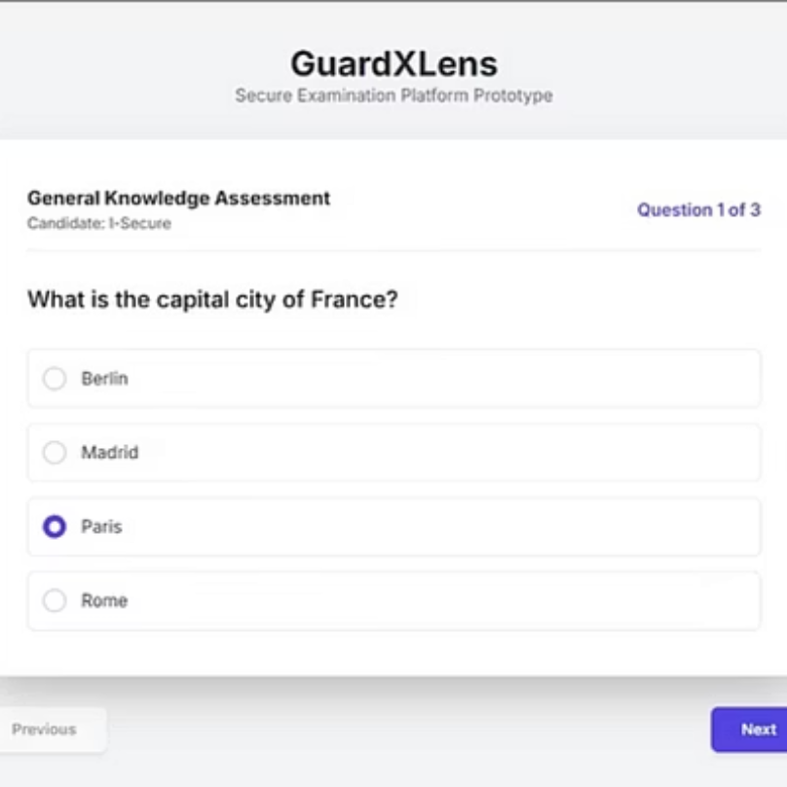
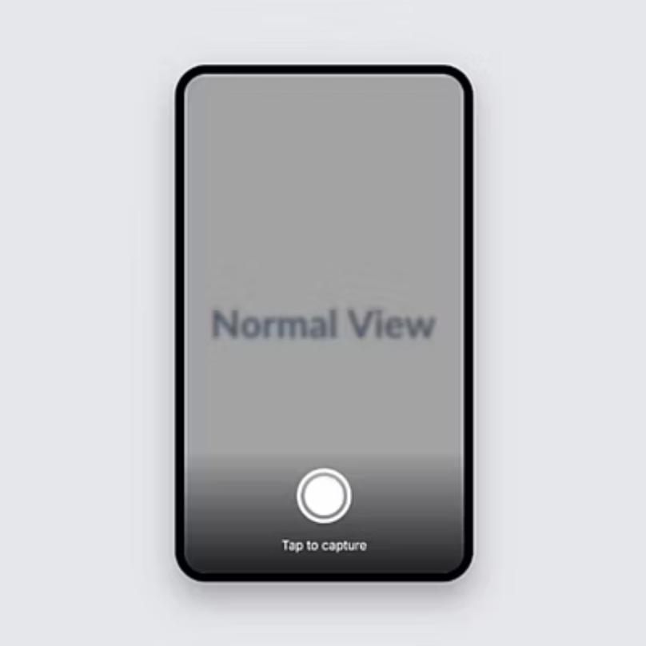
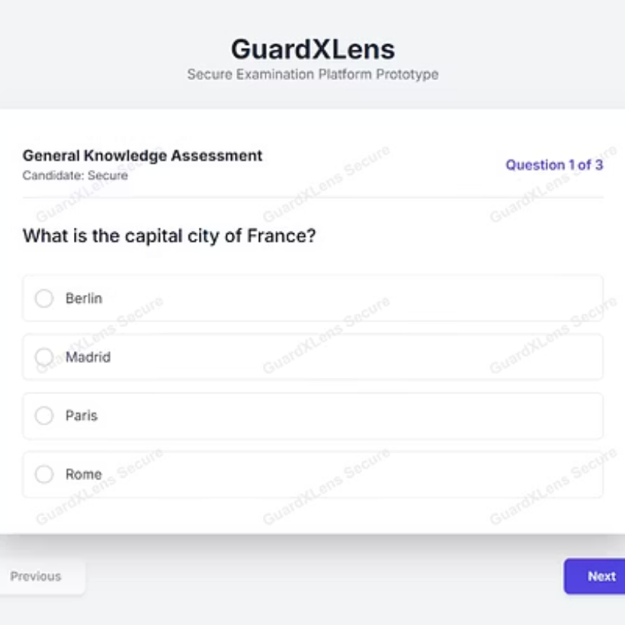
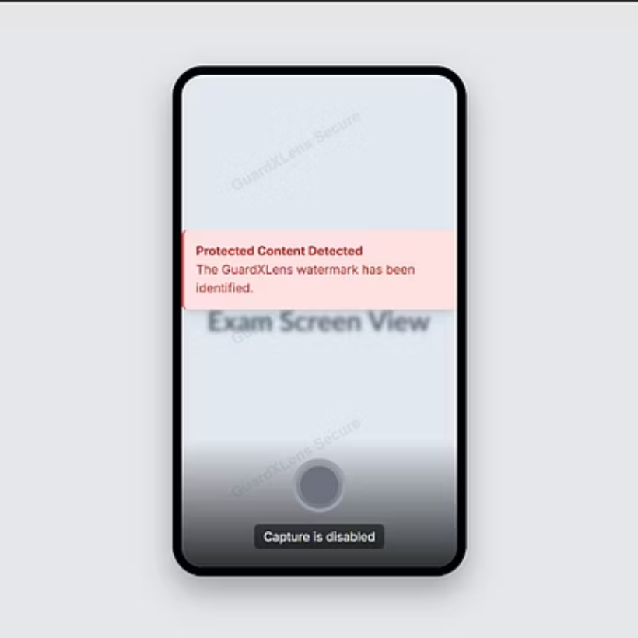
Prototype & Demo — What We'll Show
Key Interactions:
When a user attempts to capture the screen using the default system camera, the OS-level detection module recognizes the watermark pattern and automatically disables the camera preview or capture function.
Functionality:
The watermark acts as a visual security layer, and the integrated camera control prevents image or video capture in real time—ensuring secure and cheat-proof examinations.

Slide 8
Roadmap & Milestones
Current Progress:
Prototype built with exam interface displaying visible, universal watermark.
System-level modification integrated with default camera to detect watermark and block capture in real time.
Initial testing demonstrates successful prevention of screenshots and camera-based content capture.
Next 30/60/90 Days:
30 Days: Refine watermark design, optimize camera detection accuracy, and improve UI/UX for exam interface.
60 Days: Conduct pilot testing with limited users, collect feedback, and integrate subscription/licensing features.
90 Days: Expand compatibility across multiple devices, finalize prototype, and prepare provisional patent filing.
Long-Term Vision:
Scale GuardLens for educational, corporate, and government examination platforms.
Develop analytics dashboard for exam administrators to monitor integrity metrics.
License technology globally, integrate into OS-level security frameworks, and continuously enhance AI detection for emerging malpractice methods.

Slide 9
Meet the Core Technical Team
We have assembled a focused, multi-disciplinary team with the specific expertise required to tackle both the complex AI detection and the system-level integration challenges.
Name
Role
Skill / Expertise
Background / Credentials
Durgesh Kumar R
Product Manager/Computer Vision Developer
Project management, full-stack development
B.Tech IT (Pre-final Year), experience in web & mobile apps
Jeeva B
AI & Computer Vision Developer
Deep learning, computer vision, OS-level camera integration
Trained CNN models, prior AI-based projects
Barath M
Front-End & UI
HTML, CSS, JavaScript, React, responsive design
Built interactive web apps and dashboards
Nithish S
Platform & Integration Developer
Node.js, API integration, database, testing
Experience in secure platform development

Slide 10
What We Want for GuardLens
Funding: To complete system-level AI camera integration, UI/UX refinement, and large-scale pilot testing.
Mentorship: Expert guidance in AI, computer vision, Android system development, and online assessment security.
Partnerships: Collaborations with educational institutions, online exam platforms, and corporate assessment providers.
Feedback: Validate effectiveness of watermark detection, camera-blocking accuracy, and user experience.
Support: Assistance in filing complete patents and expanding the technology globally.

Slide 11
Thank You
Contact & Connect
Email: rdurgesh2110@gmail.com
LinkedIn:https://www.linkedin.com/in/rdurgesh2110/
GitHub: https://github.com/Durgesh-2110
GuardLens — Capture Nothing, Secure Everything.

